Slide 1
Never-Snooze Alarm clock
By Catherine Baker

Slide 2
Table of contents
Idea and purpose | Preventing alarm-snoozing and promoting good sleep
Instructions and functions | What can it do and how does it work?
demo | Real life look at the prototype
Design and structure | Design and circuit diagrams and layout
Future directions | Design and function recommendations

Slide 3
Idea and purpose
Preventing alarm-snoozing and promoting good sleep

Slide 4
Good sleep = good study
Snooze button
Poor focus
grogginess
Poor grades

Slide 5
Solution
01
02
Button game
No Snooze button

Slide 6
Instructions and functions
Telling time, setting an alarm, button game

Slide 7
Functions
01
02
03
Telling the time
Setting an alarm
Button game
The current time is set through the coded program
Left top button for hours. Right top button for minutes
LED visuals to indicate which button to press in a sequence. Alarm stays on until all buttons are pressed.

Slide 8
Demo
How does this work in real life?

Slide 9
Design and structure
Prototype design, box design, circuit diagram, physical culmination

Slide 10
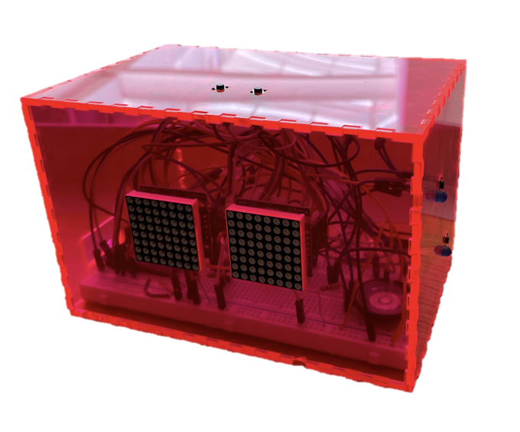
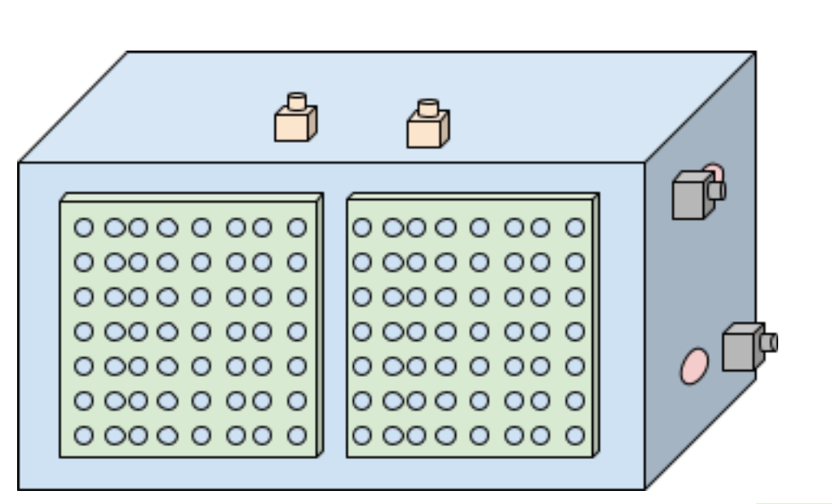
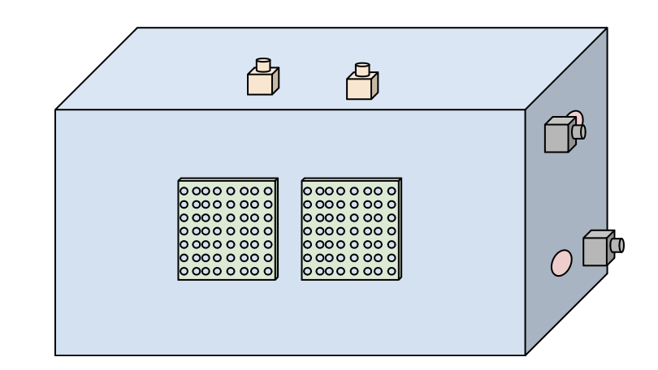
Design Progression
Initial
Intermediate
Final

Slide 11
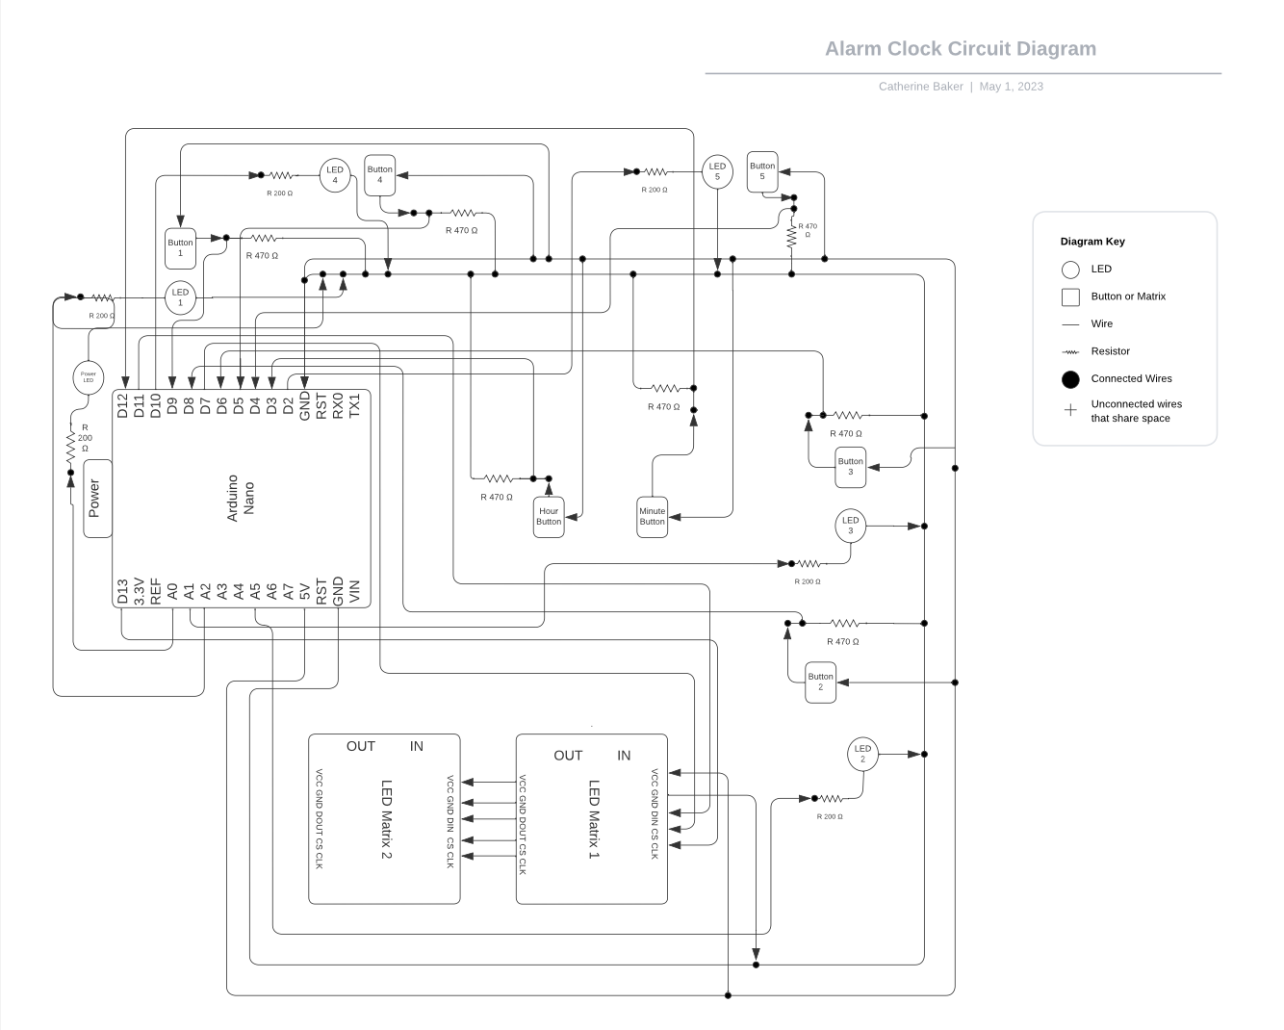
Circuit diagram

Slide 12
Future recommendations
What could we have done better? What can we do next time?

Slide 13
Possibilities out of our scope
01
accessibility
02
Focus testing
Visual, audio, even sensory aids to identify buttons
Game complexity and product design

Slide 14
Thank you

